Slide 1






AUTOMATED DETECTION OF
LUNGS CANCER USING DEEP LEARNING MODEL
BY:
Heet Patel & Mehakpreet singh
Affilation – Ontario Tech Univeristy
Date- 19-11-2024

Slide 2
OVERVIEW
INTRODUCTION
BACKGROUND AND LITERATURE REVIEW
METHODOLOGY
RESULT
DISCUSSION
CONCLUSION

Slide 3

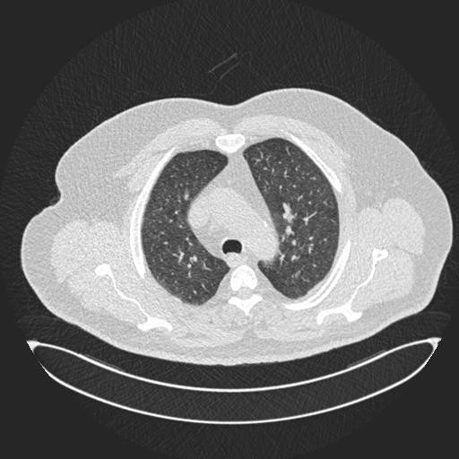
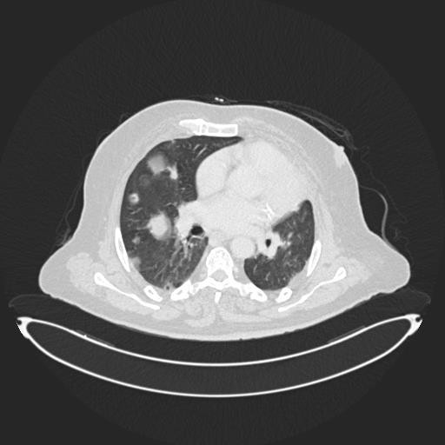
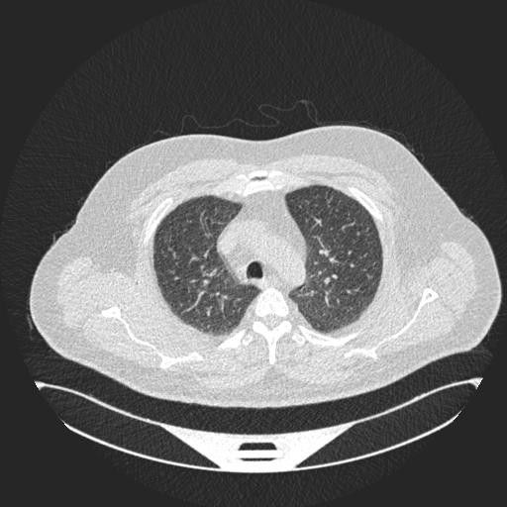
INTRODUCTION
The experiment was very effective in the model it had come up with for finding lung cancer, where 0.9973 was the training accuracy with 0.99 validation accuracy in classification for the detection of cancer. A web application was developed that will be able to upload lung X-rays and detect cancerous infections of a lung. After the trained model gets the uploaded images, the model would apply convolution neural network layers that would further apply pooling layers for detection.
This technological development will expand the accuracy and efficiency of diagnostics. The overall systematic literature review deep learning models and techniques in field of cancer in lung research is provided in this work that will help new comers/practitioners and the upcoming research.
normal
malignant
benign

Slide 4

BACKGROUND AND LITERATURE REVIEW
Use of CNN’S MODELS
The focus on CNN's feature extraction capabilities refers to its layered architecture, which gradually identifies patterns in lung tissue. It offers great accuracy for both training (0.9973) and validation (0.99).
MACHINE LEARNING MODELS:
Commonly used machine learning models, such SUPPORT VECTOR MACHINE , Decision Tree, and Naïve Bayes, frequently lack the depth necessary for complex nodule differentiation.
DEEP LEARNING MODELS
CNNS AND CAPSULE NETWORKS NEED A LOT OF DATA AND RESOURCES TO ACHIEVE HIGH ACCURACY.
HYBIRD MODELS :
Hybird models balance the advantages of both approaches by combining CNN for feature extraction with SVM for classification.
Capsule Networks (CapsNet):
CapsNet is to produce better segmentation as well as spatial feature capturing compared to more traditional models such as U-Net. Also advocate for CapsNet in the domain of medical imaging, where it performs better but often mentions the computational requirements, which we reduce in this paper utilizing hybrid CNN models.

Slide 5
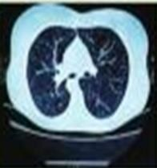
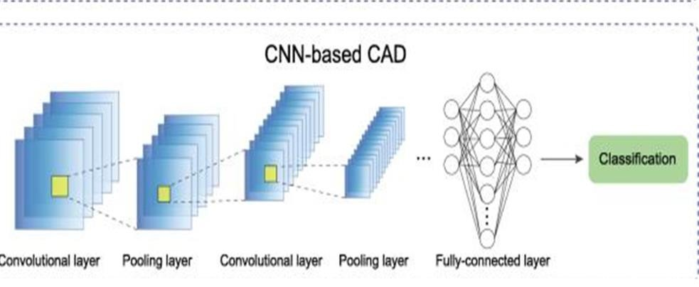
METHODOLOGY
Data collection and Preprocessing
This project utilizes high-quality medical image datasets, specifically LUNA16 and LIDC-IDRI, which contain CT scans for lung cancer detection.
For enhanced feature extraction and spatial awareness, a capsule
network (CapsNet) is applied, allowing the model to better capture the
position and properties of lung structures. CapsNet’s segmentation
capability has shown superior performance over traditional methods like U-Net, producing more accurate results. The network architecture includes two convolutional layers, providing a foundation for precise detection and classification of lung abnormalities.
How’s Model work’s?
A series of layers that progressively extract important features. The image first passes through convolutional layers, where small filters detect basic patterns like edges and textures associated with lung structure. These are followed by pooling layers, which down sample the feature maps to retain key information while reducing complexity. The process repeats with additional convolutional and pooling layers, allowing the model to learn more detailed and complex features. Finally, a fully connected layer aggregates these features and classifies the image, predicting whether the lung tissue is normal, benign, or malignant.

Slide 6
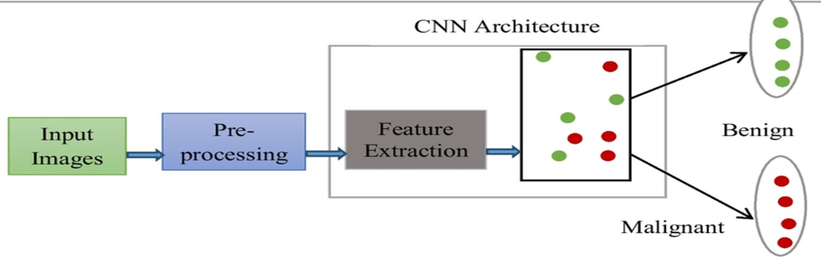
METHODOLOGY
DL - FLOW
The process begins with an Input Images, which are
typically medical scans. These images undergo Pre-
processing to enhance quality and standardize format, ensuring the data is optimal for analysis. The pre- processed images are then passed through the Feature Extraction stage within the CNN architecture, where the network identifies patterns and distinctive characteristics in the image data. These extracted features are subsequently analyzed to classify the image, determining if it falls under the Benign or Malignant category.

Slide 7
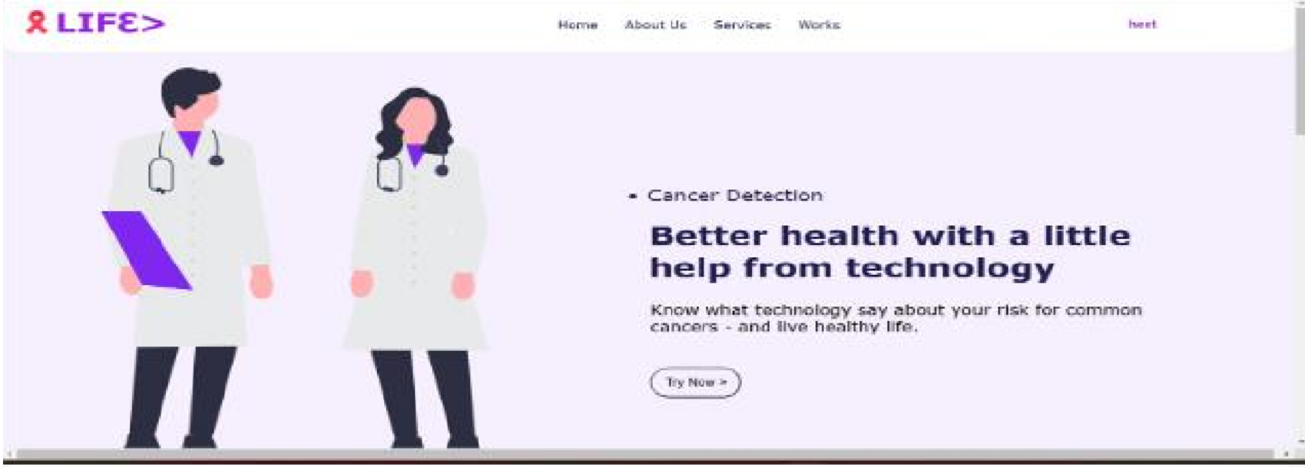
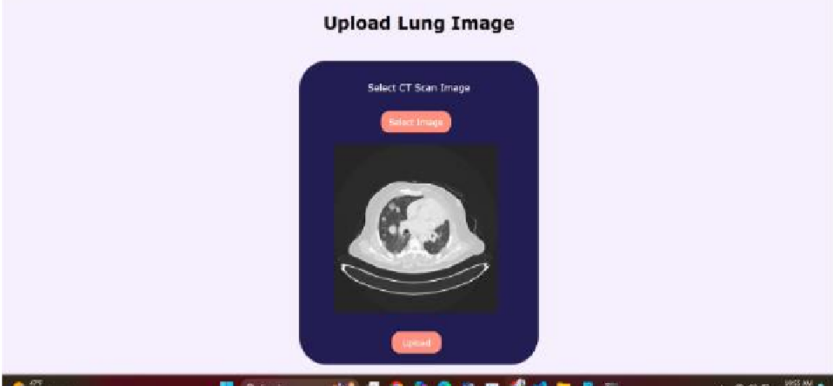
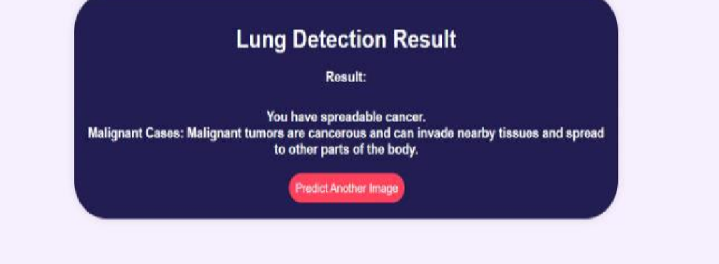
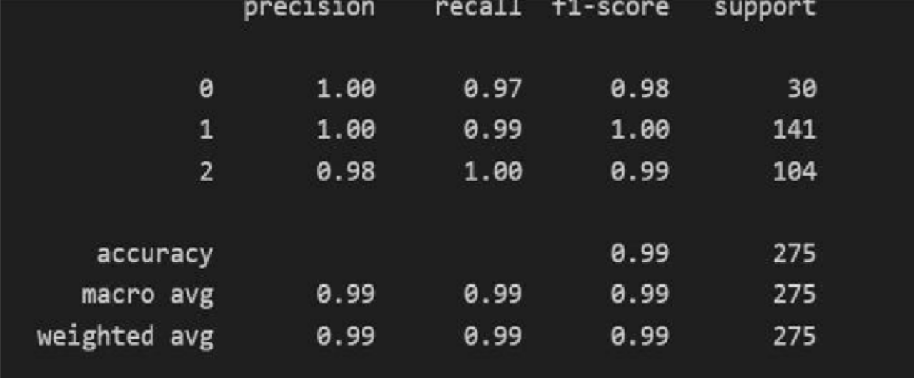
RESULT’S
In this project we have seen that our model is effectivity good to detect the lung cancer and our model training accuracy is 0.9973 and validation is also 0.99 to detect cancer. We have develop the website to upload the x-ray of lungs to detect cancer then our system the model that we have trained will use the CNN layers to use pooling layers to more classify the upload picture to detect . This technologically advanced approach improves diagnostic preciseness and effectiveness. Within the context of research related to lung cancer, this paper proposes an extended version of an SLR supported by deep learning approaches. The findings will help both the researcher and the practitioner in:
WEBSITE PAGE
UPLOADED IMAGE OF LUNGS X-RAY
OUR MODEL TRAINING AND VALIDATION ACCURACY
OUR MODEL TRAINING AND VALIDATION ACCURACY

Slide 8
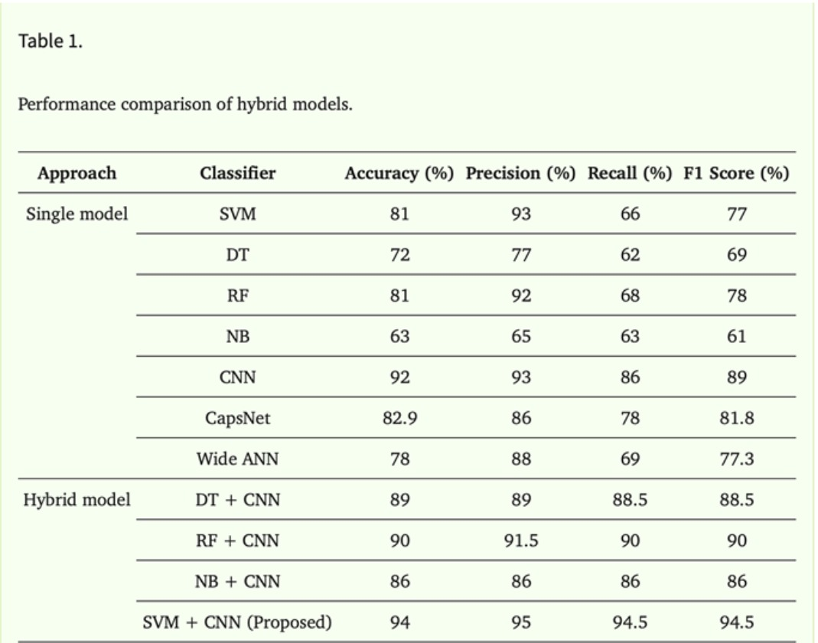
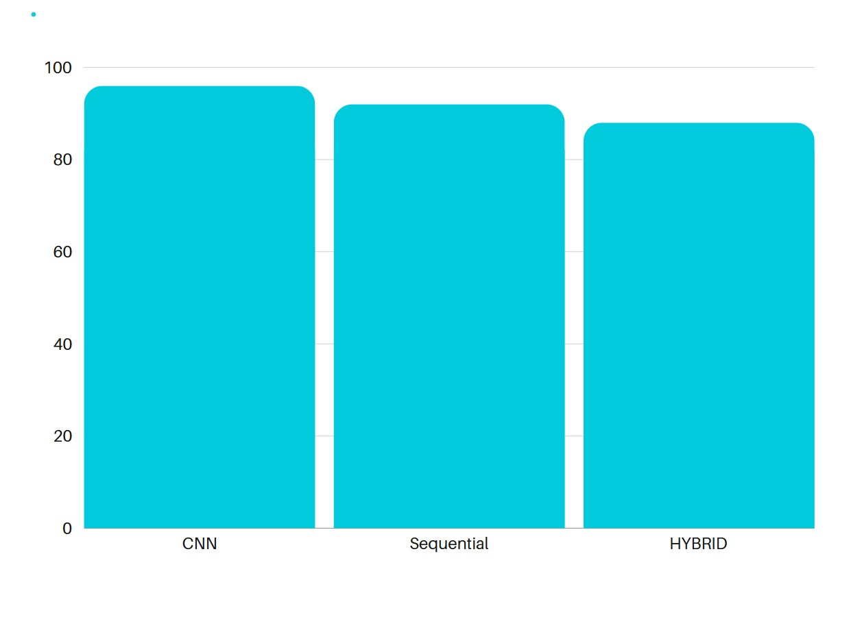
DISCUSSION
OTHER RESEARCHER HYBIRD MODEL
OUR CNN , SEQUENTIAL , HYBIRD MODEL

Slide 9
NO | OTHER RESEARCH | OUR RESEARCH
1 | DATASET Lndb 50 dataset: Contains 379 non- duplicated lung CT SCANS of nodule images for early cancer dectection. Nodule Database 73 nodules in 60 thoracic CT scans from the Society of Photo-Optical Instrumentation Nederland-Leuvens (NELSON): CT scans of 15523 human patients | DATASET Luna16 lung nodule analysis challenge. These images include procedures like image scaling, normalisation, and augmentation , 888 CT images f rom LIDC-IDRI datset
2 | IMAGE METHODS Ultrasound Non-invasive, radiation-free ultrasonography that can be used at the bedside; operator-dependent low ability to detect bone blockages or lung parenchyma gas. MRI (magnetic resonance imaging) which could result in lengthy scan periods and limited , High cost, need for contrast agents | IMAGE METHOD Computed tomography (CT) screening for lung cancer, diagnosis of lung disease, evaluation of the extent of lung cancer, and detection of pulmonary emboli is useful for assessing lung nodules and has a high resolution and sensitivity for detecting small or early-stage lung cancers. Expensive, possible requirement for a contrast agent, and high radiation dose

Slide 10


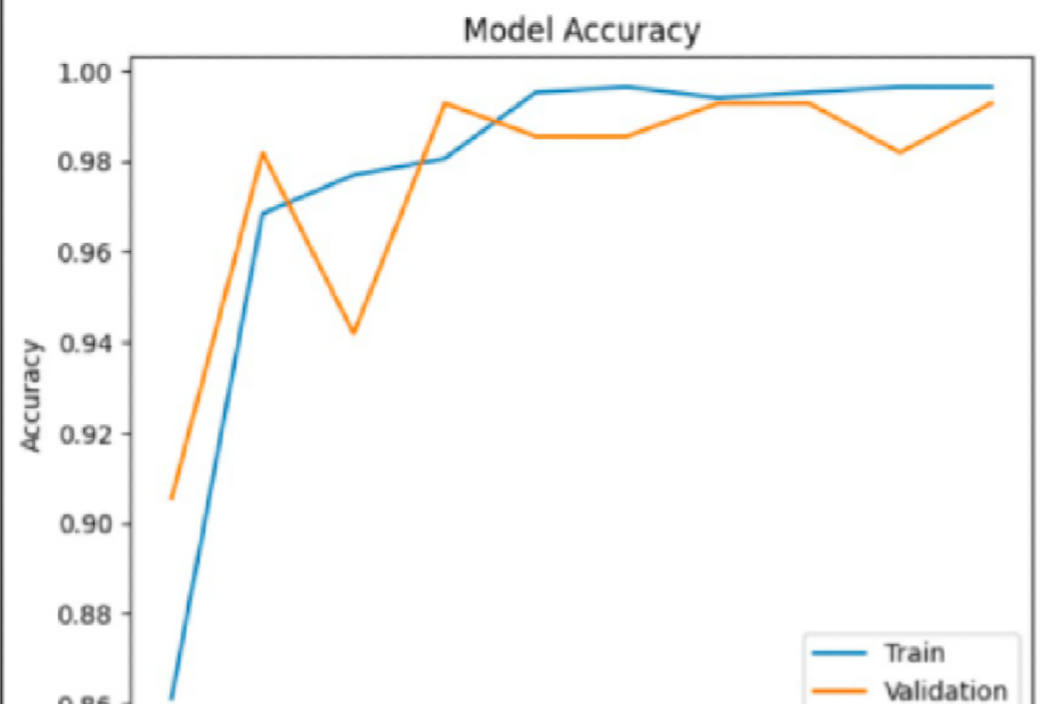
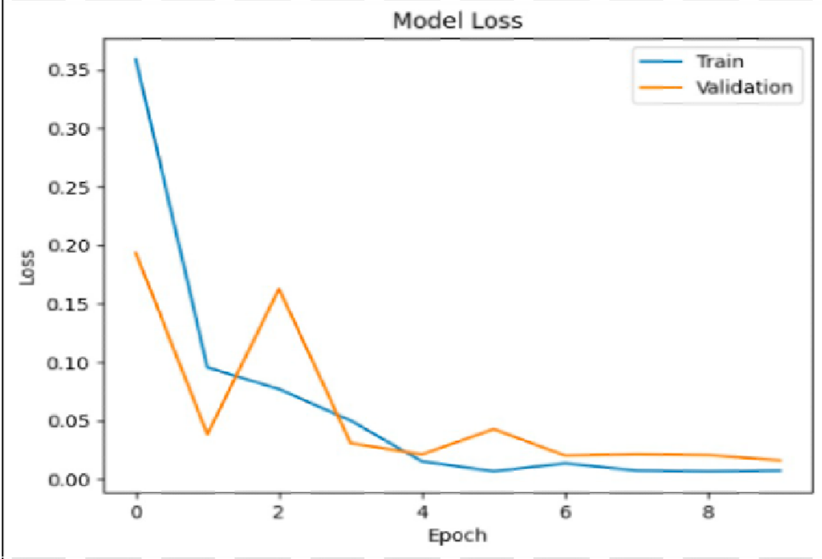
CONCLUSION
The wide research itself is a breakthrough in the diagnosis of cancers, and a new SCNN model is developed for diagnosis. Care has been taken to design the approach with its subsequent implementation to realize the most effective detection of lung conditions using computed tomography images. In addition, all the used methods suffer from limitations regarding their sensitivity because of the variability in soft tissues.
This study bears witness to the level of creativity and perseverance it takes to take full advantage of advanced technologies with a view to improving patient outcomes and diagnostic precision. Further improvements are planned regarding our model by integrating expert opinions and new ideas to increase its effectiveness in various clinical settings.

Slide 11




Thank You
For your attention

